Slide 1

BANK
ANALYTICS

Slide 2

INTRODUCTION
The aim of this project is to analyze loan data, the focus of the project has been on analyzing and visualizing Bank Analytics to gain insights into various aspects of the business. The project has involved synthesizing complex Bank Loan data into actionable insights, enabling informed decision-making within the Banking department. It will help to understand the overall relation between the customers and loans.
The dataset used for this analysis are as follows with each containing over 39000 plus records.
Datasets:
Finance_1.xlsx
Finance_2.csv
Tools Used
Data Cleaning : Microsoft Excel, Power Query (ETL)
Data Visualisation : Power BI, Tableau, Microsoft Excel
MySQL Workbench 8.0

Slide 3
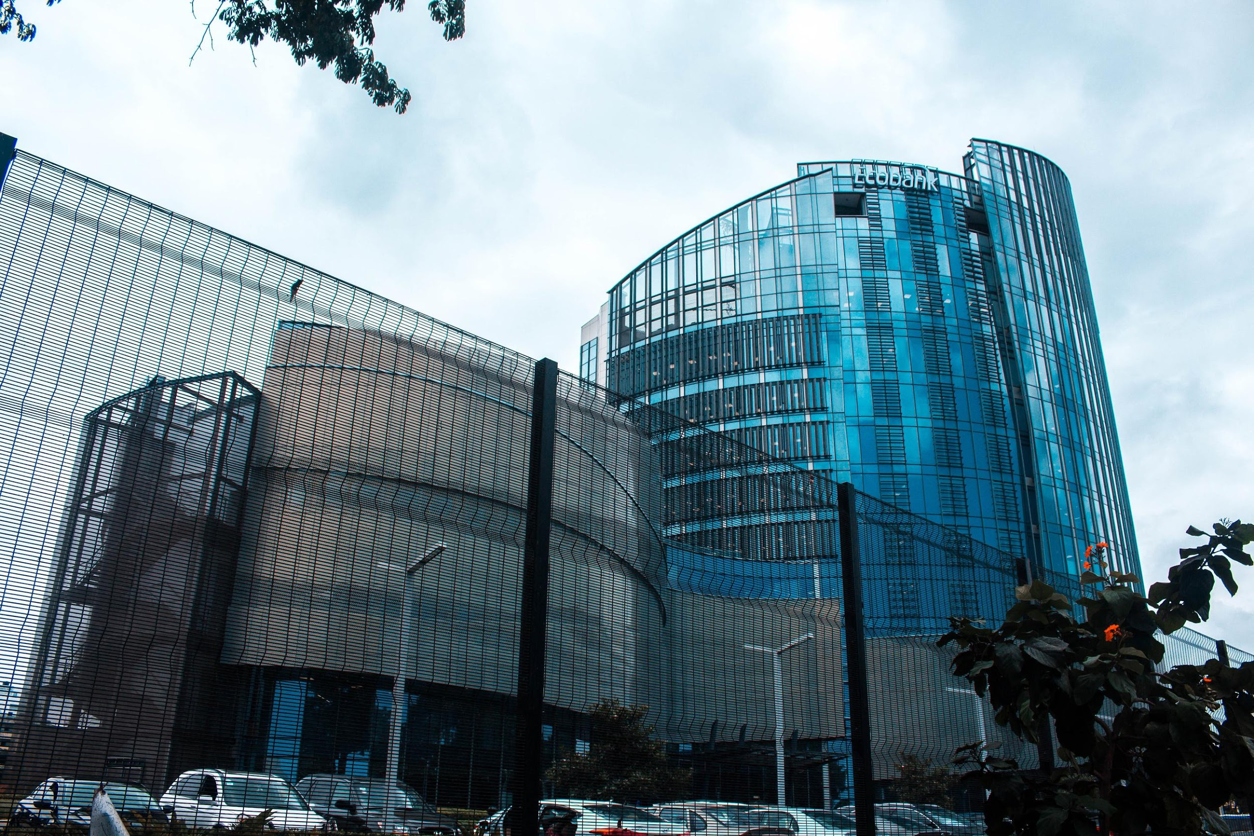





BANK ANALYSIS KPI’S
Year Wise Loan Amount Stats
Grade and Sub Grade wise Revolving Bal
Total Payment for Verified vs Non Verified Status
State wise and Month Wise Loan status
Home Ownership vs Last Payment Date Status

Slide 4

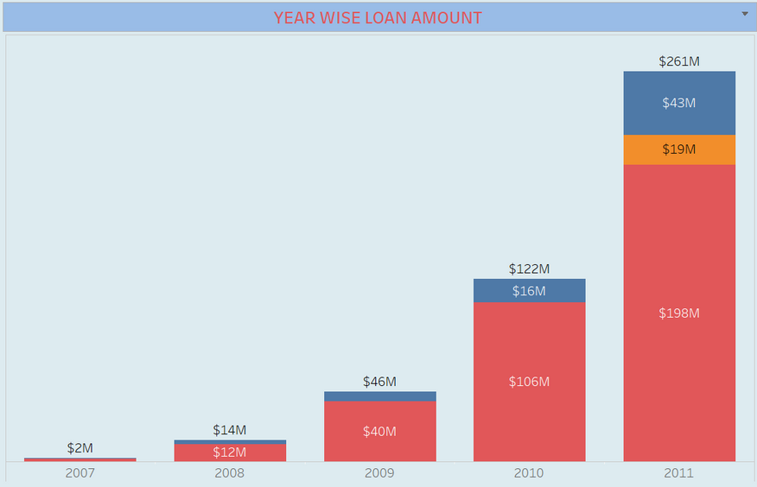

KPI 1 : YEARWISE LOAN AMOUNT STATS
Helps to identify trends and pattern in loan disbursement.
There is exponential growth of loan amount from the year 2007 to 2011, increased from 2 Million to 261 Million dollars.
It means that bank aims to be profitable and hold good position in further years considering the growth.
This analysis can help banks to make informed decisions about their lending policies and strategies

Slide 5
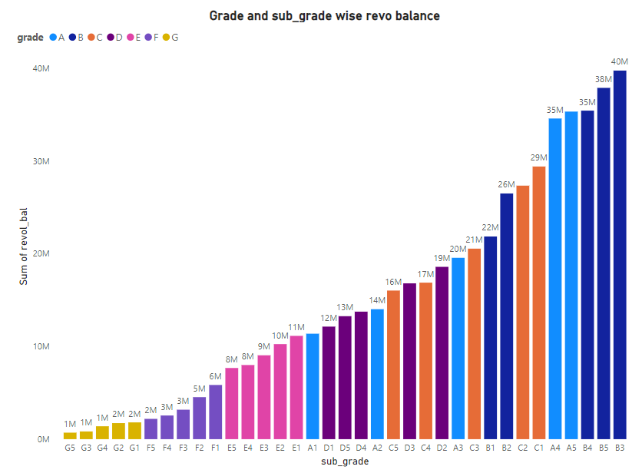
KPI 2 : GRADE AND SUB-GRADEWISE REVOLVING BALANCE
The revolving balance is the amount of credit that a borrower has available to them on a credit card or other line of credit.
Helps to analyse the distribution of Revolving balance across loan grades and subgrades.
Sub-grade B3 has the highest revolving balance i.e 40 Million
The lowest revolving balance is in Grade G for Sub-grade G5 i.e 1 Million

Slide 6
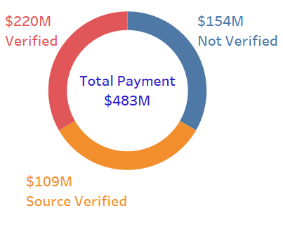
KPI 3 : TOTAL PAYMENT FOR VERIFIED VS NON-VERIFIED STATUS
Verification status defines the borrower’s account is verified, source verified or non-verified.
We can observe that 68% Borrowers having the verified bank account (both verified and source verified) and 32% borrowers have the bank account which are not verified.
Around 220 Million dollars of total payment received by the verified borrowers and remaining 154 Million dollars received by non-verified borrowers.

Slide 7
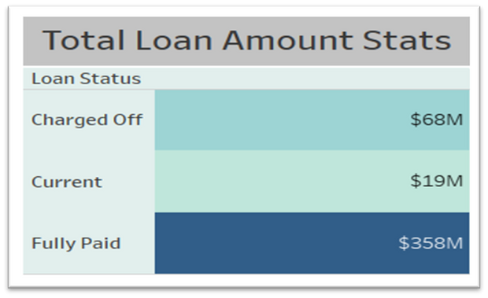
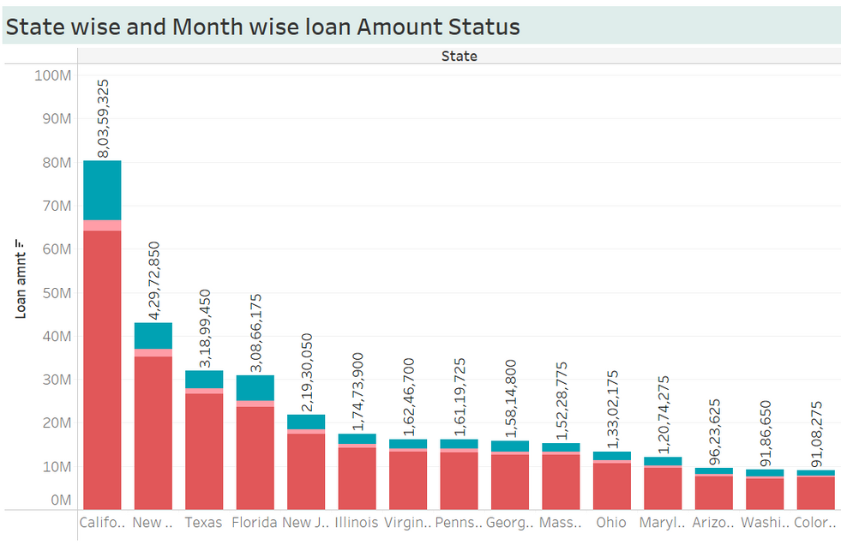
KPI 4 : STATE WISE AND MONTH WISE LOAN STATUS
The Total Fully paid loan is $358 M, total current is $19M, total charged off loan amount is $68 M.
Maine, Iowa, Indiana are the states which have fully paid loan status with no current or charged off values.
California, New york, Florida has highest charged off values.
Charged off borrowers are red flags for the bank as lender or creditor has written the account off as a loss, and the account is closed to future charges. Bank considered them as NPA (non performing assets).

Slide 8
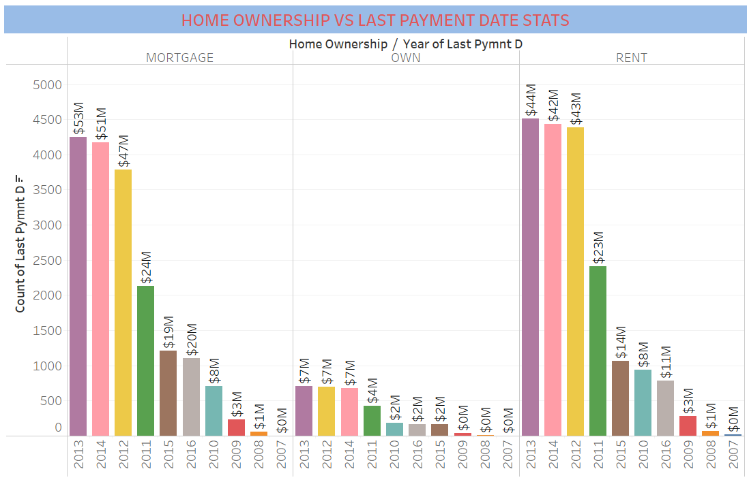
KPI 5 : HOME OWNERSHIP VS LAST PAYMENT DATE STATS
This analysis can provide insights into the relationship between home ownership and payment punctuality, which can be used to tailor communication or support for homeowners based on their payment history
By analysing, we can say that year 2013 has highest total payment received by the bank during their timestamp.

Slide 9

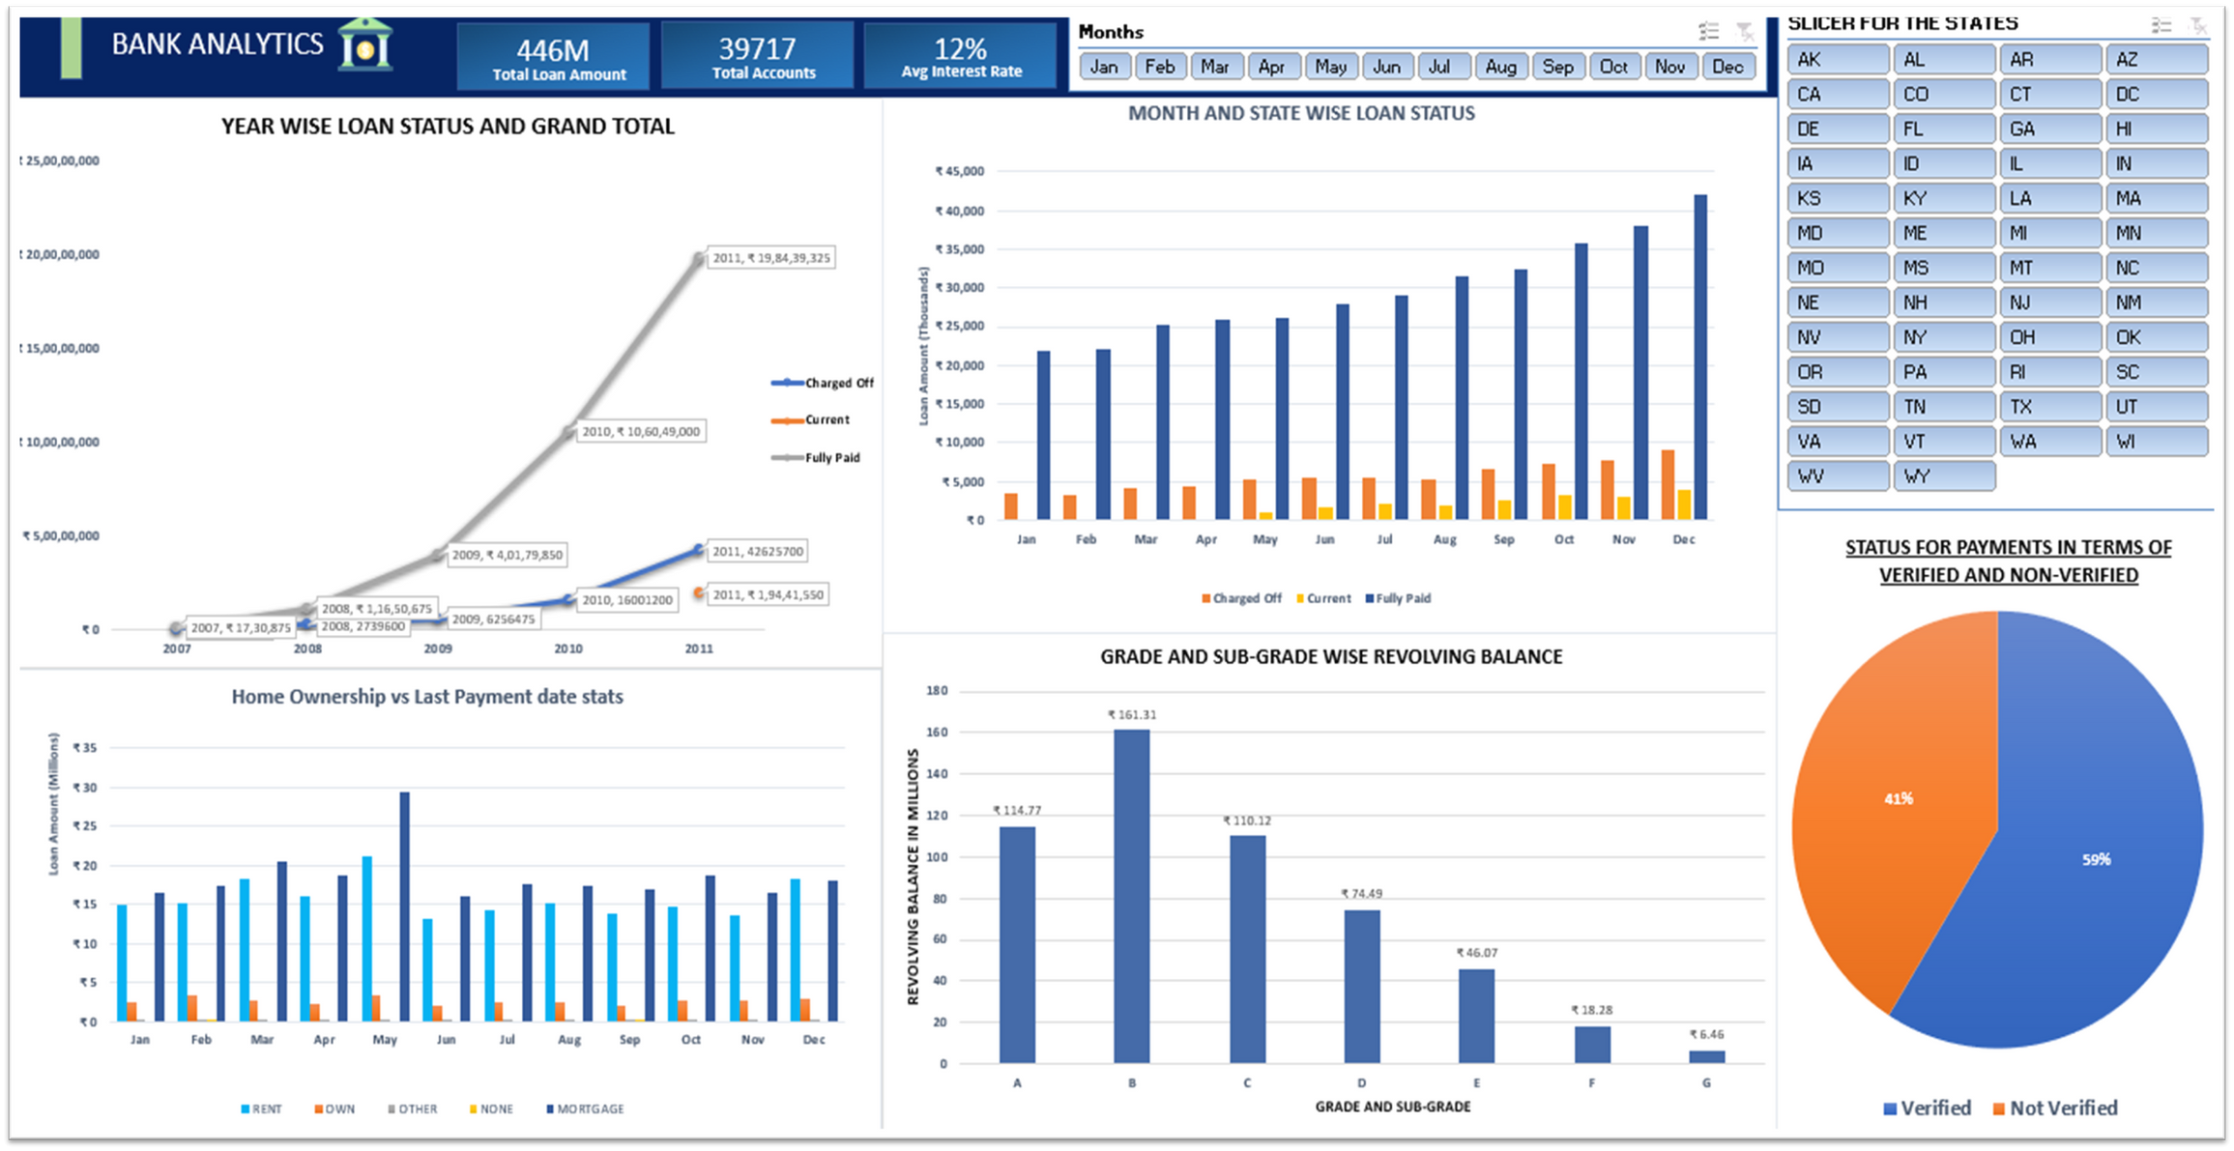
DASHBOARD IN EXCEL

Slide 10
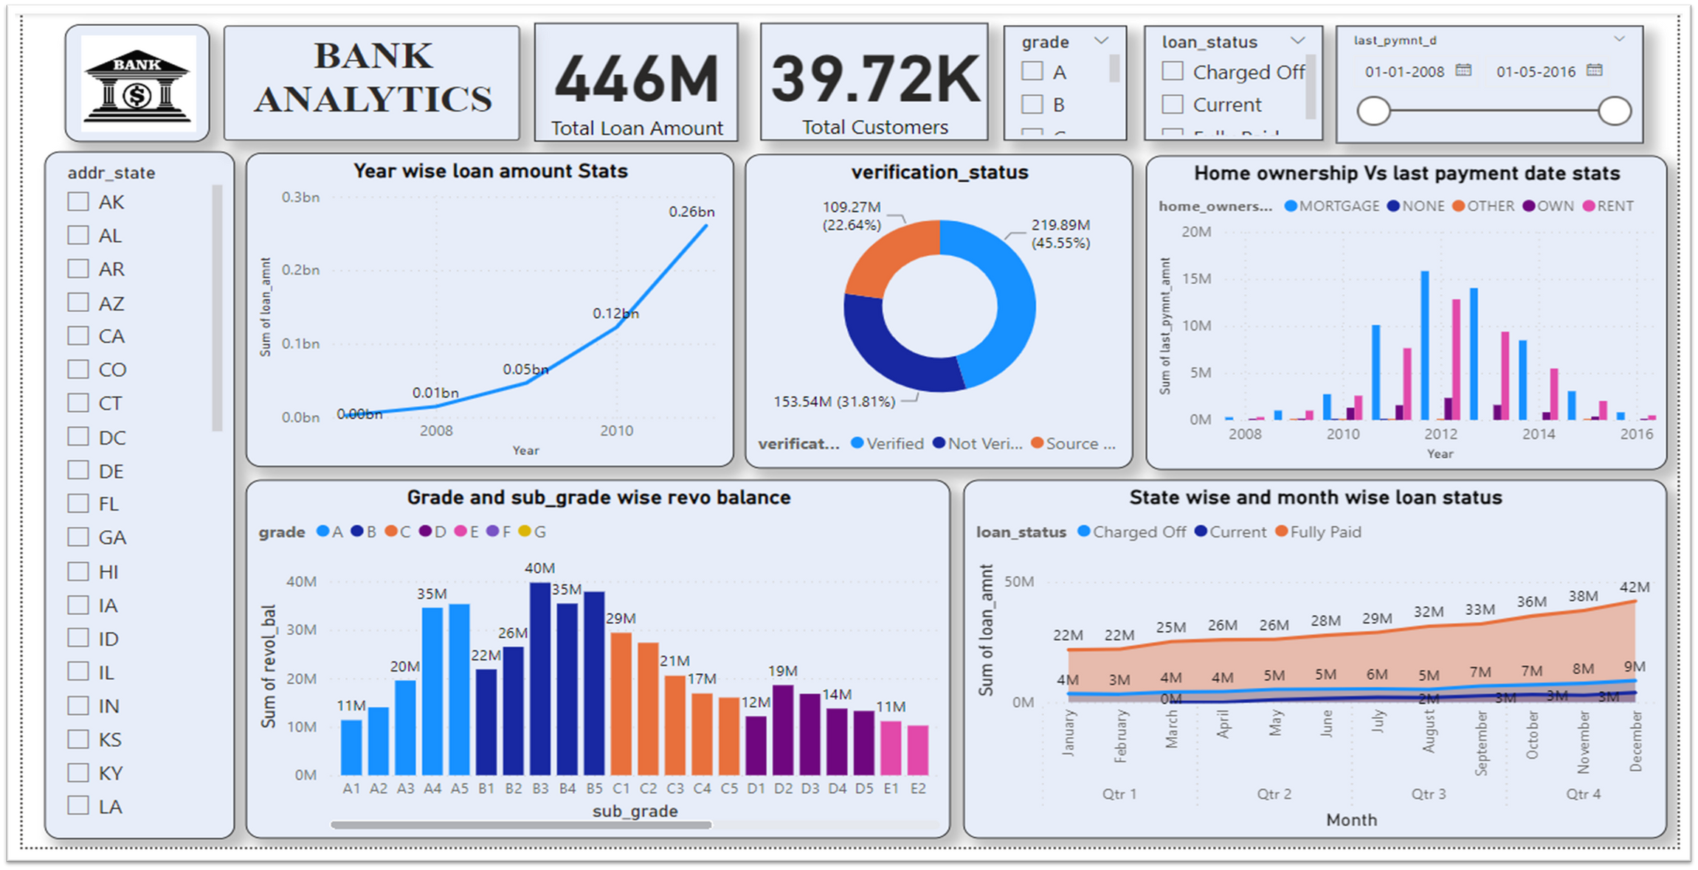
DASHBOARD IN POWER BI

Slide 11
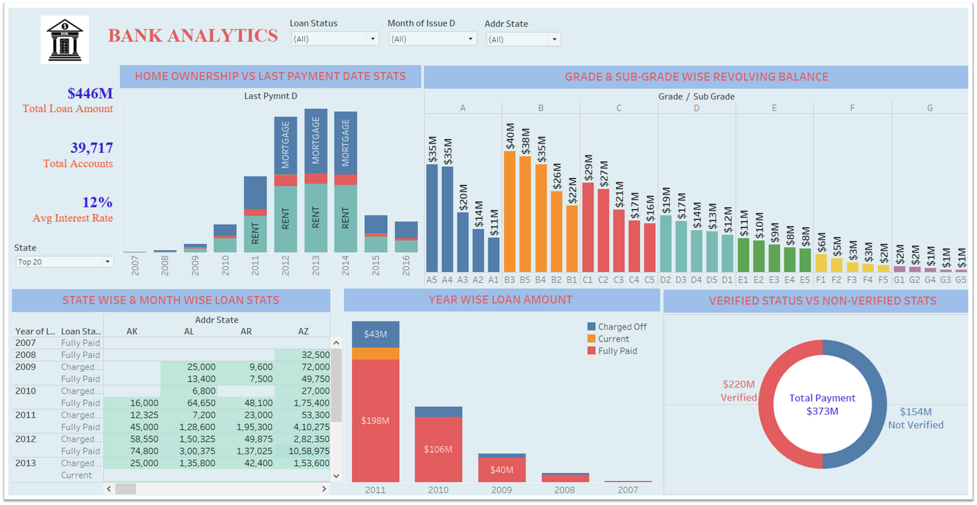
DASHBOARD IN TABLEAU

Slide 12
SUGGESTIONS AND CONCLUSIONS
1
Bank can increase its lending capacity to meet the growing demand
2
Bank can take corrective actions and tailor the strategies to mitigate the future risk for Sub-Grade B4, B5, B3.
3
As the total payment made by verified customers is higher, this information can be used to make informed decisions about loan approvals, credit limits, and other financial services.
4
California, New york, Florida these states have higher charged off value so bank can investigate the reasons behind it such as the economic conditions of the state, customer earnings or the bank’s own policies.
5
By analyzing the payment behavior of customers based on their home ownership status, banks can assess risk accurately, offer financial education, and customize products.

Slide 13
THANK YOU

